Slide 1

ANZ Data@ANZ Virtual Program
Task 2 – Predictive Analytics
https://github.com/nemote95/ANZ-Data-Program/blob/master/ANZ.ipynb
Negar Mohammadhassan

Slide 2
Feature analysis
The correlation of numerical features of customers to their salarywere not very significant, so new features were derived.
Derived features with posetive significant correlation :
customer's median month of transactions (0.23)
average number of debit transactions(0.48)
avarage amount of transaction (0.29)
average balance of the account (0.20)
Derived features with negative significant correlation :
stage of the customers (-0.13)
being female (-0.15)
Also number of all types of transaction have high correlation with the salary of the customer excetp for "SALES-POS" transactions.

Slide 3
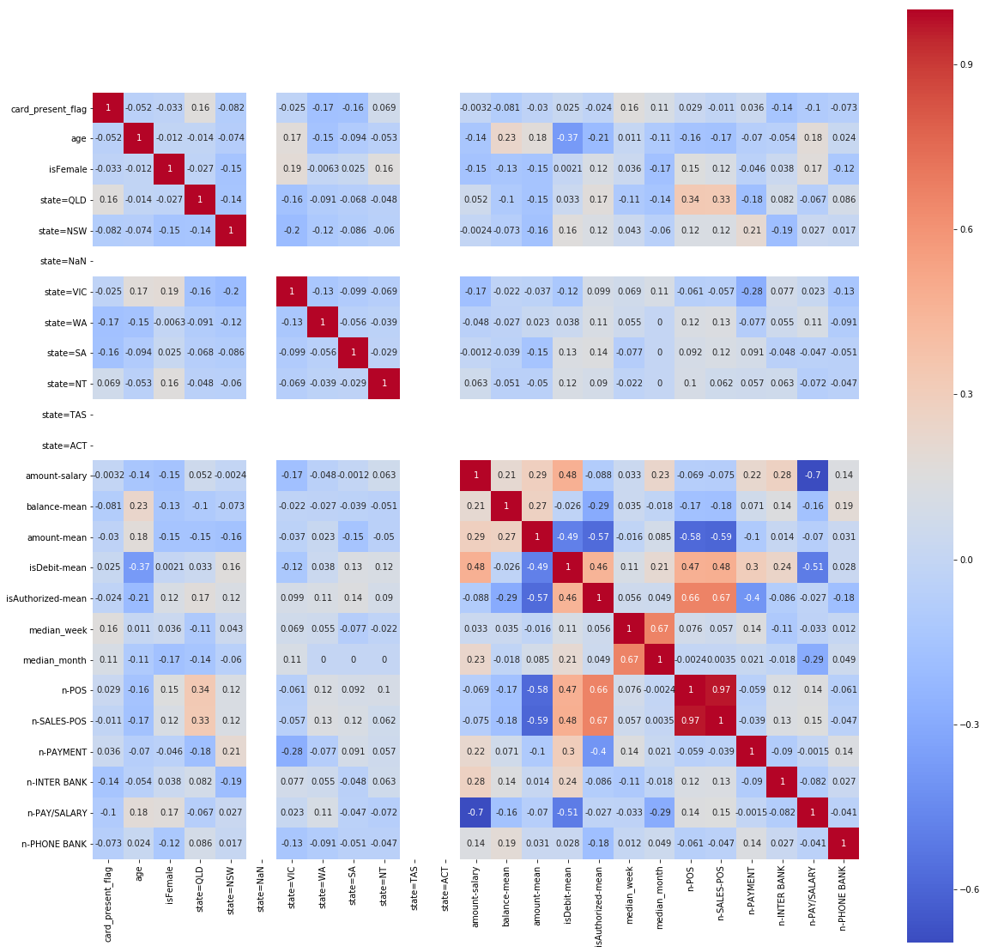
Correlations between features
This analysis is to filter out features that have high correlations to reduce the feature vector size.

Slide 4
Predictive model
After investigating the correlations between features and salary of the customers, we selected the folowing list of features:
'card_present_flag', 'age','isFemale', 'state=VIC', 'balance-mean', 'amount-mean', 'isDebit-mean', 'isAuthorized-mean','median_month', 'n-payment', 'n-Inter Bank', 'n-Phone bank'
Then, we tried linear regression to predict the salary of the customer.
Cross-validation : MSE = 871.41, R2 = 0.60 - not satisfactory
Thus, we tried decision tree. After trying various numbers of depth for the tree, we acheive higher performance than linear regression.
Cross-validation : MSE = 112.59, R2 = 0.99

Slide 5
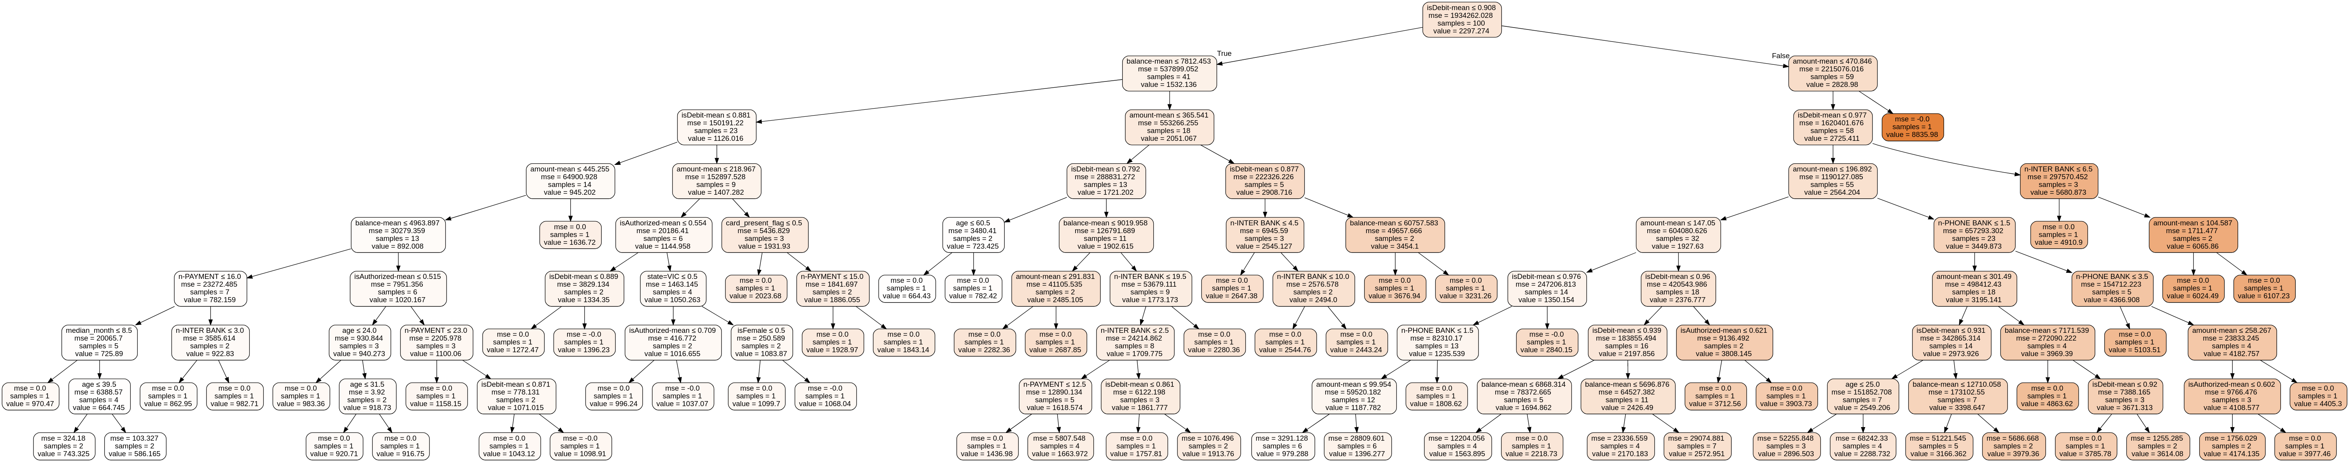
Trained Decision Tree

